Slide 1
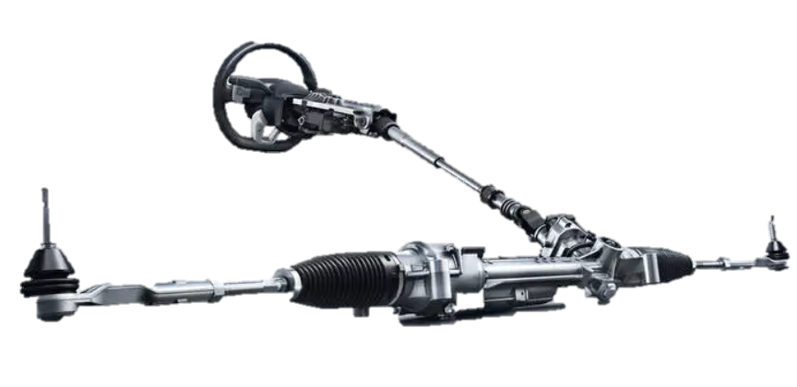
Improvements in TECHNICAL projects
Manikandan Raju

Slide 2
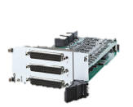
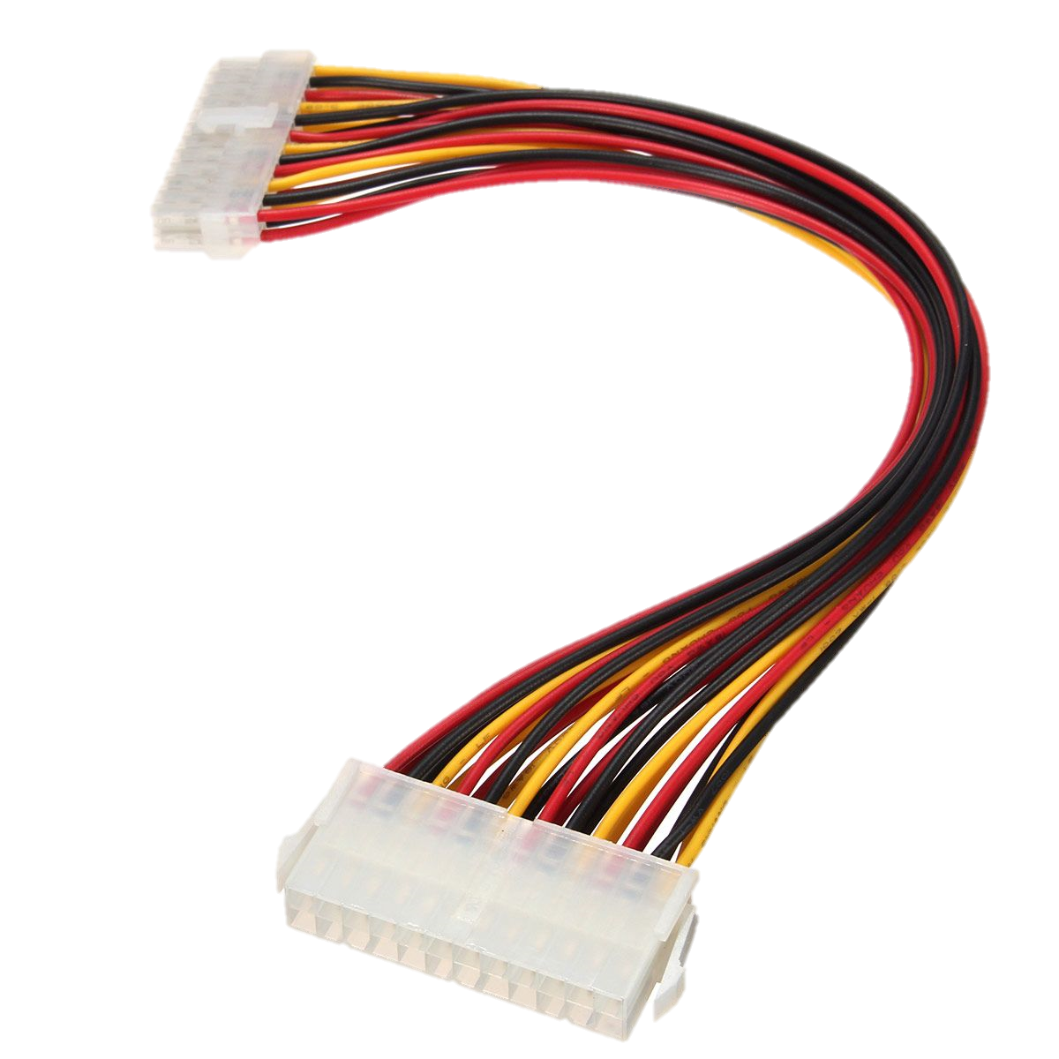
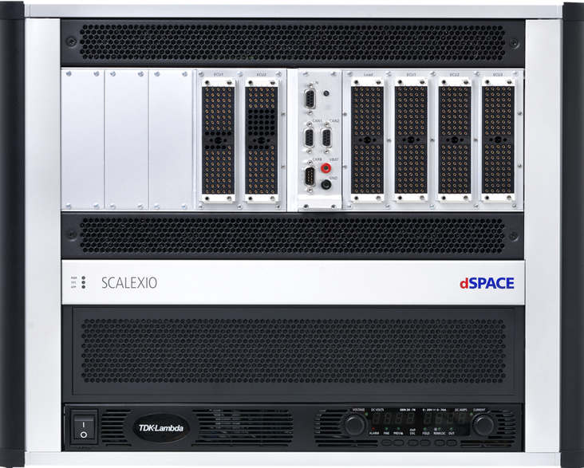
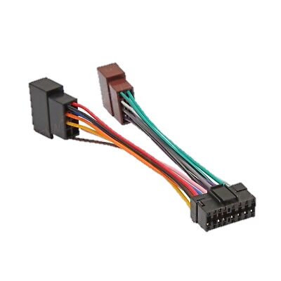
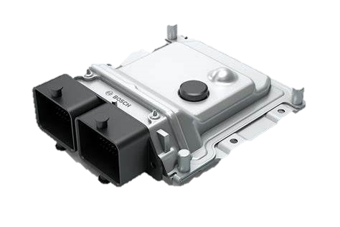
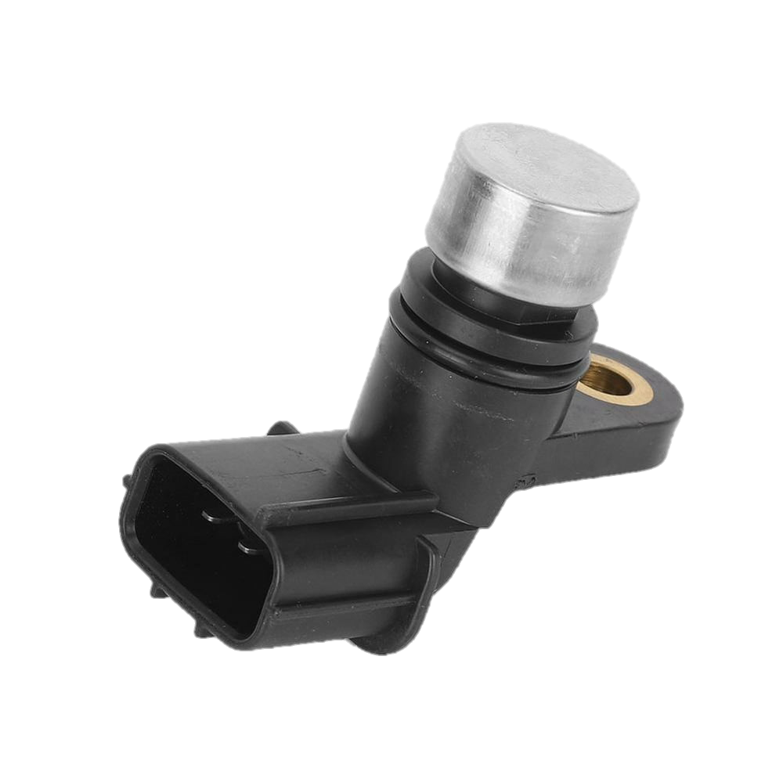
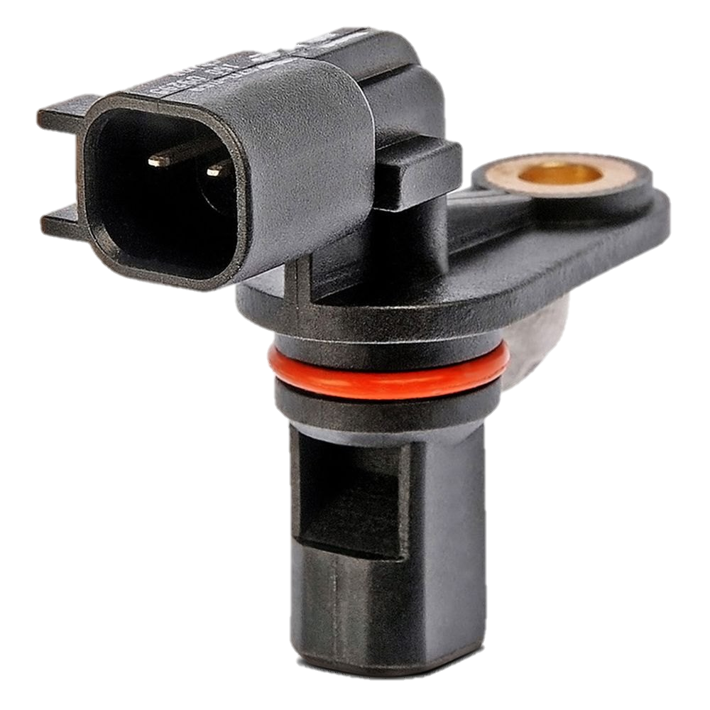
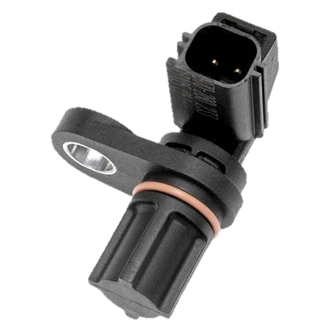
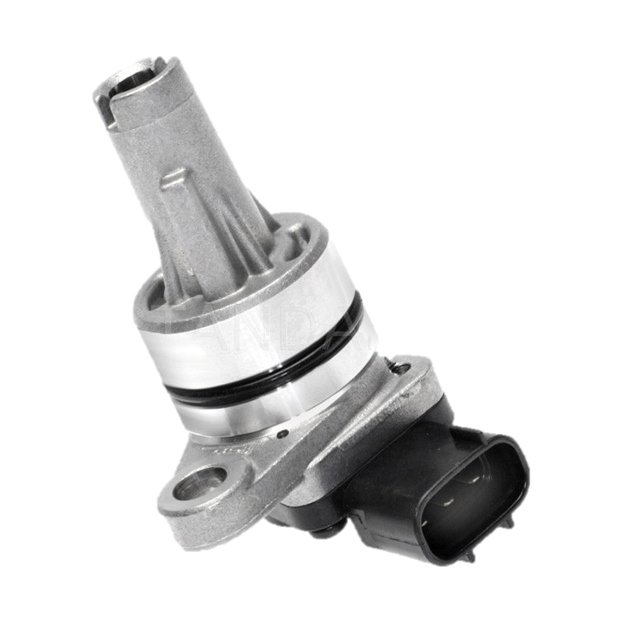
MuLTI-APPLICATION HIL TEST BEnch
DS 6101 Multi IO Board
Digital In/Out (PWM)
Analog In/Out
Resistor Simulation
Engine Simulation
Plugin connector
Y connections to common I/O Pins
Separate connections to unique I/O Pins
HIL Simulator
Steering ECU (ICE)
Steering ECU (Electric)
Body Control ECU (ICE)
Body Control ECU
(Electric)
Steering Angle Sensor S100
Steering Torque Sensor S200
Steering Angle Sensor S101
Steering Torque Sensor S201
Vehicle Speed Sensor S301
Vehicle Speed Sensor S302

Slide 3
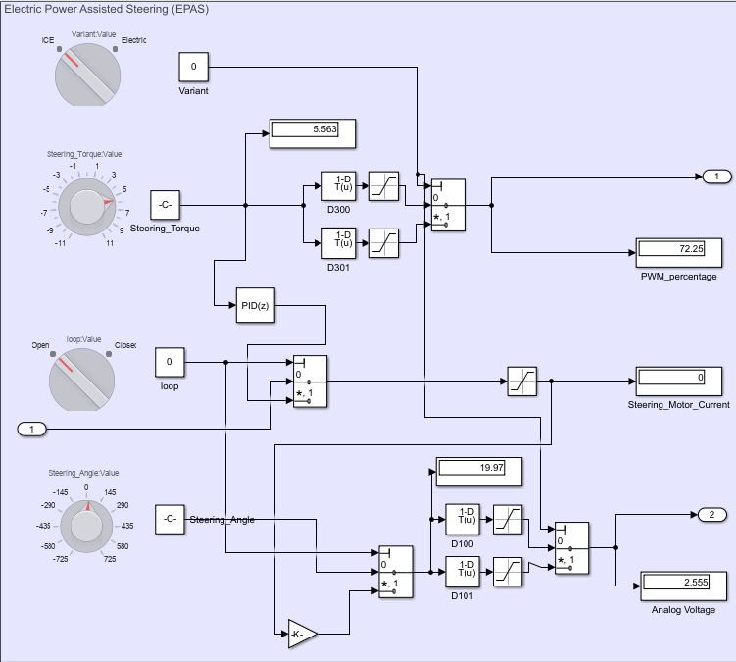
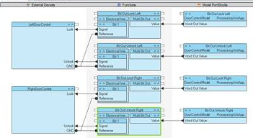
DEMO – MULTI APP HIL TEST BENCH (EPAS)
Simulink Model (Open/Closed loop)
Configuration Desk
Signal Chain
Port Connection

Slide 4

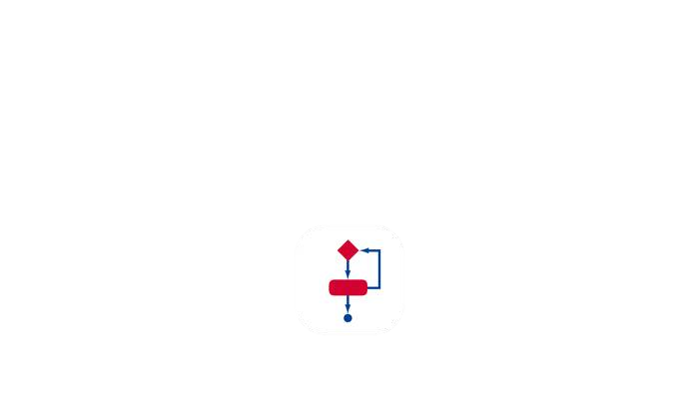





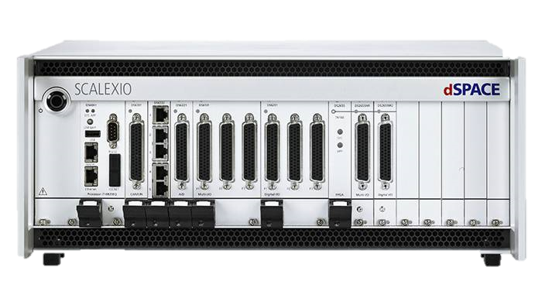
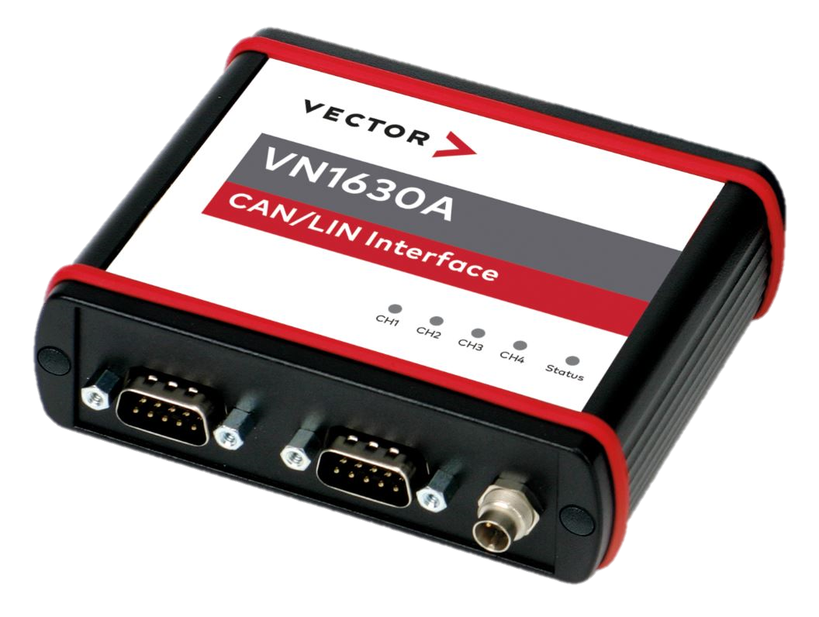
Integration of dspace and vector tools via com api
COM API
Importing win32com client module in python scripts
CANoe Application is opened with COM API
Loading CANoe Configuration with databases, CAPL program nodes and Test modules.
Starting the measurement analysis and CAPL Test module Testcases are executed.
CANoe System Variables could be accessed and set by Automation desk python scripts.
Stopping the measurement in CANoe.
Test Results are generated and exported and also could be passed to Automation desk.

Slide 5
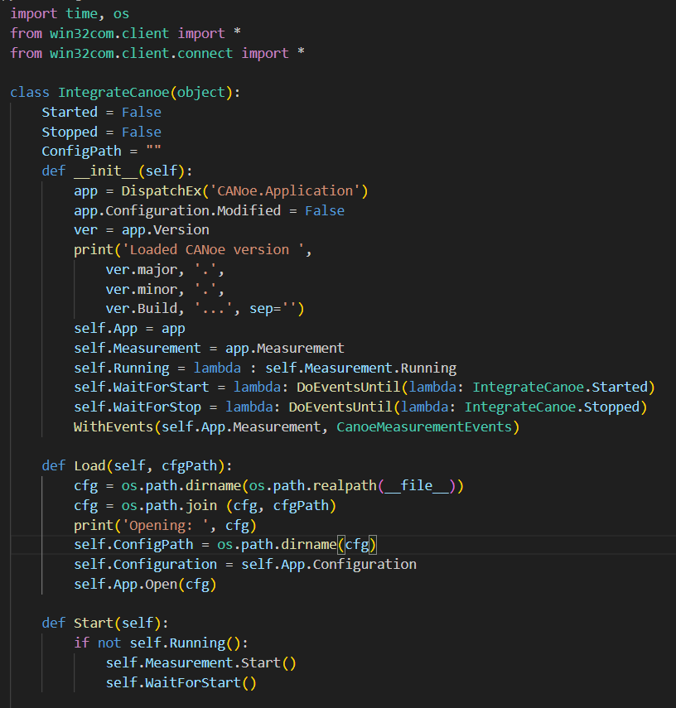
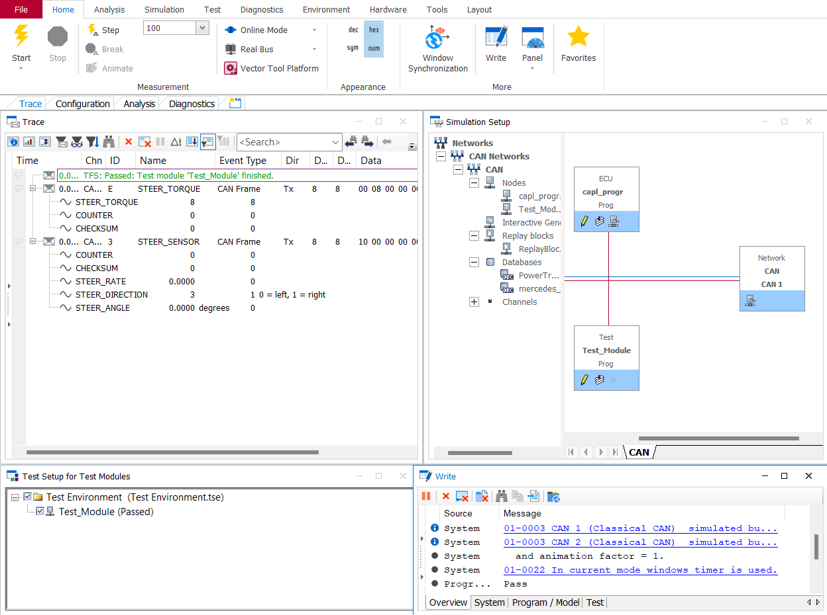
DEMO - Integration of dspace and vector tools via com api
Automation desk Python Script with COM API
CANoe Application loading and running Test modules
COM API

Slide 6
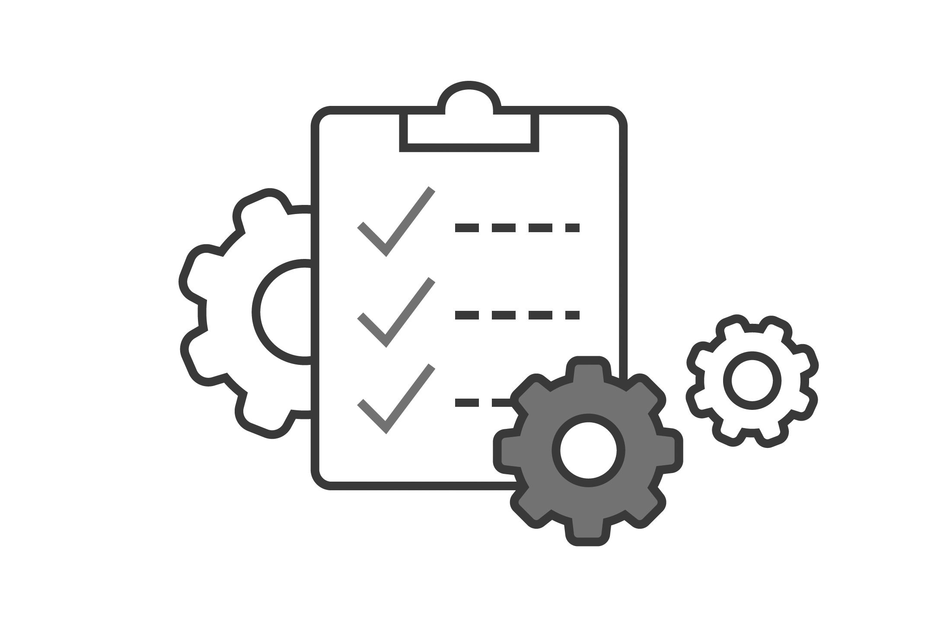


Syncing HIL MEASUREMENT DATA WITH Cycle TIME
HIl/SIL
Measurement File
Meas Sync Script
Test Automation

Slide 7
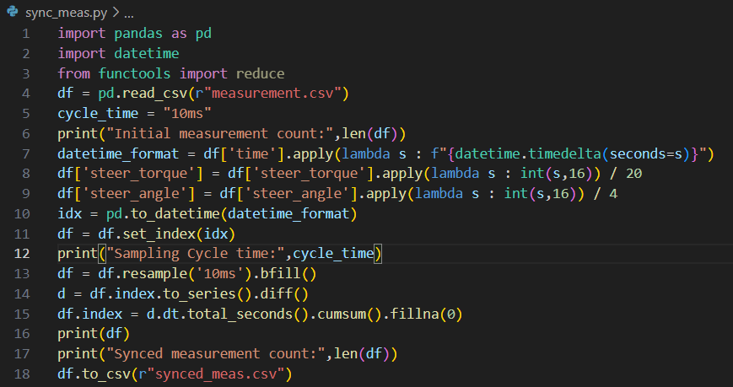
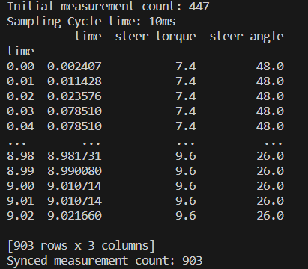
DEMO - Syncing HIL MEASUREMENT DATA WITH Cycle TIME

Slide 8
MuLTI-APPLICATION HIL TEST Bench
HIL Simulator
HIL Simulator
Steering ECU E002
Body Control ECU E102
Steering ECU E001
Body Control ECU E101
Steering Angle Sensor S100
Steering Torque Sensor S200
Steering Angle Sensor S101
Steering Torque Sensor S201
Vehicle Speed Sensor S302
Vehicle Speed Sensor S301

